Slide 1
public class Employee
{
public int Id { get; set; }
[Required(ErrorMessage = "First name is required")]
[StringLength(50)]
public string FirstName { get; set; }
[Required(ErrorMessage = "Last name is required")]
[StringLength(15)]
public string LastName { get; set; }
[Range(0, 10, ErrorMessage = "Rating must be between 0 and 10")]
public int Rating { get; set; }
[RegularExpression("^[0-9]{10}$", ErrorMessage = "Phone number must be 10 digits")]
public string PhoneNumber { get; set; }
[CreditCard(ErrorMessage = "Invalid credit card number")]
public string CreditCardNumber { get; set; }
[MaxLength(500)]
public string Bio { get; set; }
[MinLength(6, ErrorMessage = "Password must be at least 6 characters long")]
public string Password { get; set; }
}
using System.ComponentModel.DataAnnotations;
The StringLength data annotation is used to define the maximum length of a string property.

Slide 2
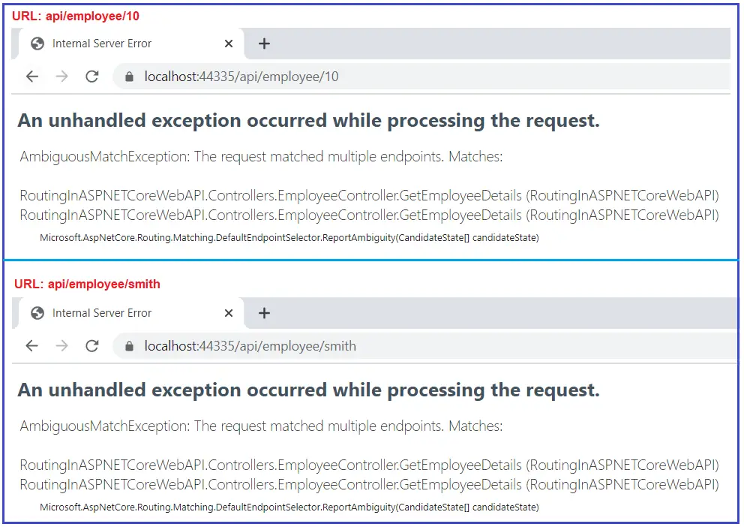
using Microsoft.AspNetCore.Mvc;
namespace RoutingInASPNETCoreWebAPI.Controllers
{
[ApiController]
[Route("api/[controller]")]
public class EmployeeController : ControllerBase
{
[Route("{EmployeeId}")]
public string GetEmployeeDetails(int EmployeeId)
{
return $"Response from GetEmployeeDetails Method, EmployeeId : {EmployeeId}";
}
[Route("{EmployeeName}")]
public string GetEmployeeDetails(string EmployeeName)
{
return $"Response from GetEmployeeDetails Method, EmployeeName : {EmployeeName}";
}
}
}
when the request comes, the application does not identify which version of the GetEmployeeDetails() method to use, and hence it gives an Ambiguous Match Exception as two end pints match the same request. This is the situation where the Route Constraints come into the picture in ASP.NET Core Web API.

Slide 3
Route Constraints in ASP.NET Core Web API Application
Type: int, double, bool, float, datetime, etc
Min: min(number)
Max: max(number)
Range: range(10. 15)
Alpha: alpha
MinLength: minlength(5)
MaxLength: maxlength(10)
Length: length(10)
Required: required
Regex: regex(expression)

Slide 4
Constraint | Description | Example
alpha | Matches uppercase or lowercase Latin alphabet characters (a-z, A-Z) | {x:alpha}
bool | Matches a Boolean value. | {x:bool}
datetime | Matches a DateTime value. | {x:datetime}
decimal | Matches a decimal value. | {x:decimal}
double | Matches a 64-bit floating-point value. | {x:double}
float | Matches a 32-bit floating-point value. | {x:float}
guid | Matches a GUID value. | {x:guid}
int | Matches a 32-bit integer value. | {x:int}
length | Matches a string with the specified length or within a specified range of lengths. | {x:length(6)} {x:length(1,20)}
long | Matches a 64-bit integer value. | {x:long}
max | Matches an integer with a maximum value. | {x:max(10)}
maxlength | Matches a string with a maximum length. | {x:maxlength(10)}
min | Matches an integer with a minimum value. | {x:min(10)}
minlength | Matches a string with a minimum length. | {x:minlength(10)}
range | Matches an integer within a range of values. | {x:range(10,50)}
regex | Matches a regular expression. | {x:regex(^\d{3}-\d{3}-\d{4}$)}

Slide 5
using Microsoft.AspNetCore.Mvc;
namespace RoutingInASPNETCoreWebAPI.Controllers
{
[ApiController]
[Route("api/[controller]")]
public class EmployeeController : ControllerBase
{
[Route("{EmployeeId:int:min(1000)}")]
public string GetEmployeeDetails(int EmployeeId)
{
return $"Response from GetEmployeeDetails Method, EmployeeId : {EmployeeId}";
}
using Microsoft.AspNetCore.Mvc;
namespace RoutingInASPNETCoreWebAPI.Controllers
{
[ApiController]
[Route("api/[controller]")]
public class EmployeeController : ControllerBase
{
[Route("{EmployeeId:int}")]
public string GetEmployeeDetails(int EmployeeId)
{
return $"Response from GetEmployeeDetails Method, EmployeeId : {EmployeeId}";
}
[Route("{EmployeeName:alpha}")]
public string GetEmployeeDetails(string EmployeeName)
{
return $"Response from GetEmployeeDetails Method, EmployeeName : {EmployeeName}";
}
}
}
Min(number) constraint in ASP.NET Core:
If you want to apply some minimum value constraint for any parameter then you can use the Min constraint. The min constraint takes one parameter i.e. the minimum value to be applied on the parameter. For example, if you want the GetEmployeeDetails(int EmployeeId) action method to be invoked only if the EmployeeId is a number greater than 1000, then you can use the min(1000) constraint in ASP.NET Core Web API as shown below.
[Route(“{EmployeeId:int}”)]
Note: we don’t need to specify anything for the string parameter as by default all the parameters in ASP.NET Core Web Application are string only.
Max(Number) constraint in ASP.NET Core Web API:
Along with the min constraint, you can also specify the max constraint in ASP.NET Core Web API. The max constraint also takes one parameter which is used to specify the max value that can be applied to the parameter. For example, if you want the EmployeeId in the URL should not to be greater than 1000, then you can use the max constraint as shown below.
[Route(“{EmployeeName:alpha}”)]
Here, alpha stands for uppercase or lowercase alphabet characters. So, changes the GetEmployeeDetails method which takes the string parameter as shown below.
[Route("{EmployeeId:int:min(100):max(1000)}")]
public string GetEmployeeDetails(int EmployeeId)
{
return $"Response from GetEmployeeDetails Method, EmployeeId : {EmployeeId}";
}

Slide 6
[Route("{EmployeeId:int:range(100,1000)}")]
public string GetEmployeeDetails(int EmployeeId)
{
return $"Response from GetEmployeeDetails Method, EmployeeId : {EmployeeId}";
}
Range Constraint in ASP.NET Core:
Instead of using the min and max constraint to specify the minimum and maximum value, we can also use the Range constraint. The Range method takes two parameters, the first parameter is the minimum value and the second parameter is the maximum value.

Slide 7
[Route("{EmployeeName:alpha:minlength(5):maxlength(10)}")]
public string GetEmployeeDetails(string EmployeeName)
{
return $"Response from GetEmployeeDetails Method, EmployeeName : {EmployeeName}";
}
It is also possible to apply both minlength and maxlength constraints on a single parameter. For example, if we want to specify the EmployeeName parameter to a minimum of 5 characters and a maximum of 10 characters, then we can apply both minlength and maxlength constraints as shown below.
[Route("{EmployeeName:alpha:length(5)}")]
public string GetEmployeeDetails(string EmployeeName)
{
return $"Response from GetEmployeeDetails Method, EmployeeName : {EmployeeName}";
}
Length Route Constraint in ASP.NET Core Web API:
The Length Route Constraint is basically used to specify the exact length of a string. This constraint takes one parameter which specifies the length to be applied for the parameter. For example, we want the GetEmployeeDetails(string EmployeeName) method to be invoked only when the EmployeeName is five characters. Then we can achieve the same very easily by using the length route constraint.

Slide 8
Regex Route Constraint in ASP.NET Core Web API:
You can also validate the value of a particular variable by using the regex route constraint. The regex takes one parameter and you can specify an expression or pattern to validate. Let us understand this with an example. Modify the GetEmployeeDetails(string EmployeeName) method as shown below. Here, we are adding a simple pattern that will validate if the string starts with the letter a and followed by b or c, then this method is going to be invoked.
[Route("{EmployeeName:regex(a(b|c))}")]
public string GetEmployeeDetails(string EmployeeName)
{
return $"Response from GetEmployeeDetails Method, EmployeeName : {EmployeeName}";
}

